Slide 1

Group Member and Roles
Abongile Loyiso Bakubaku {Researcher}
Yanga Ngqolana {Researcher}
Mbuso Cosby Ubisi {Technical}
Sange Lugalo {Technical}
Indiphe Yonwaba Nondlazi {Technical}

Slide 2
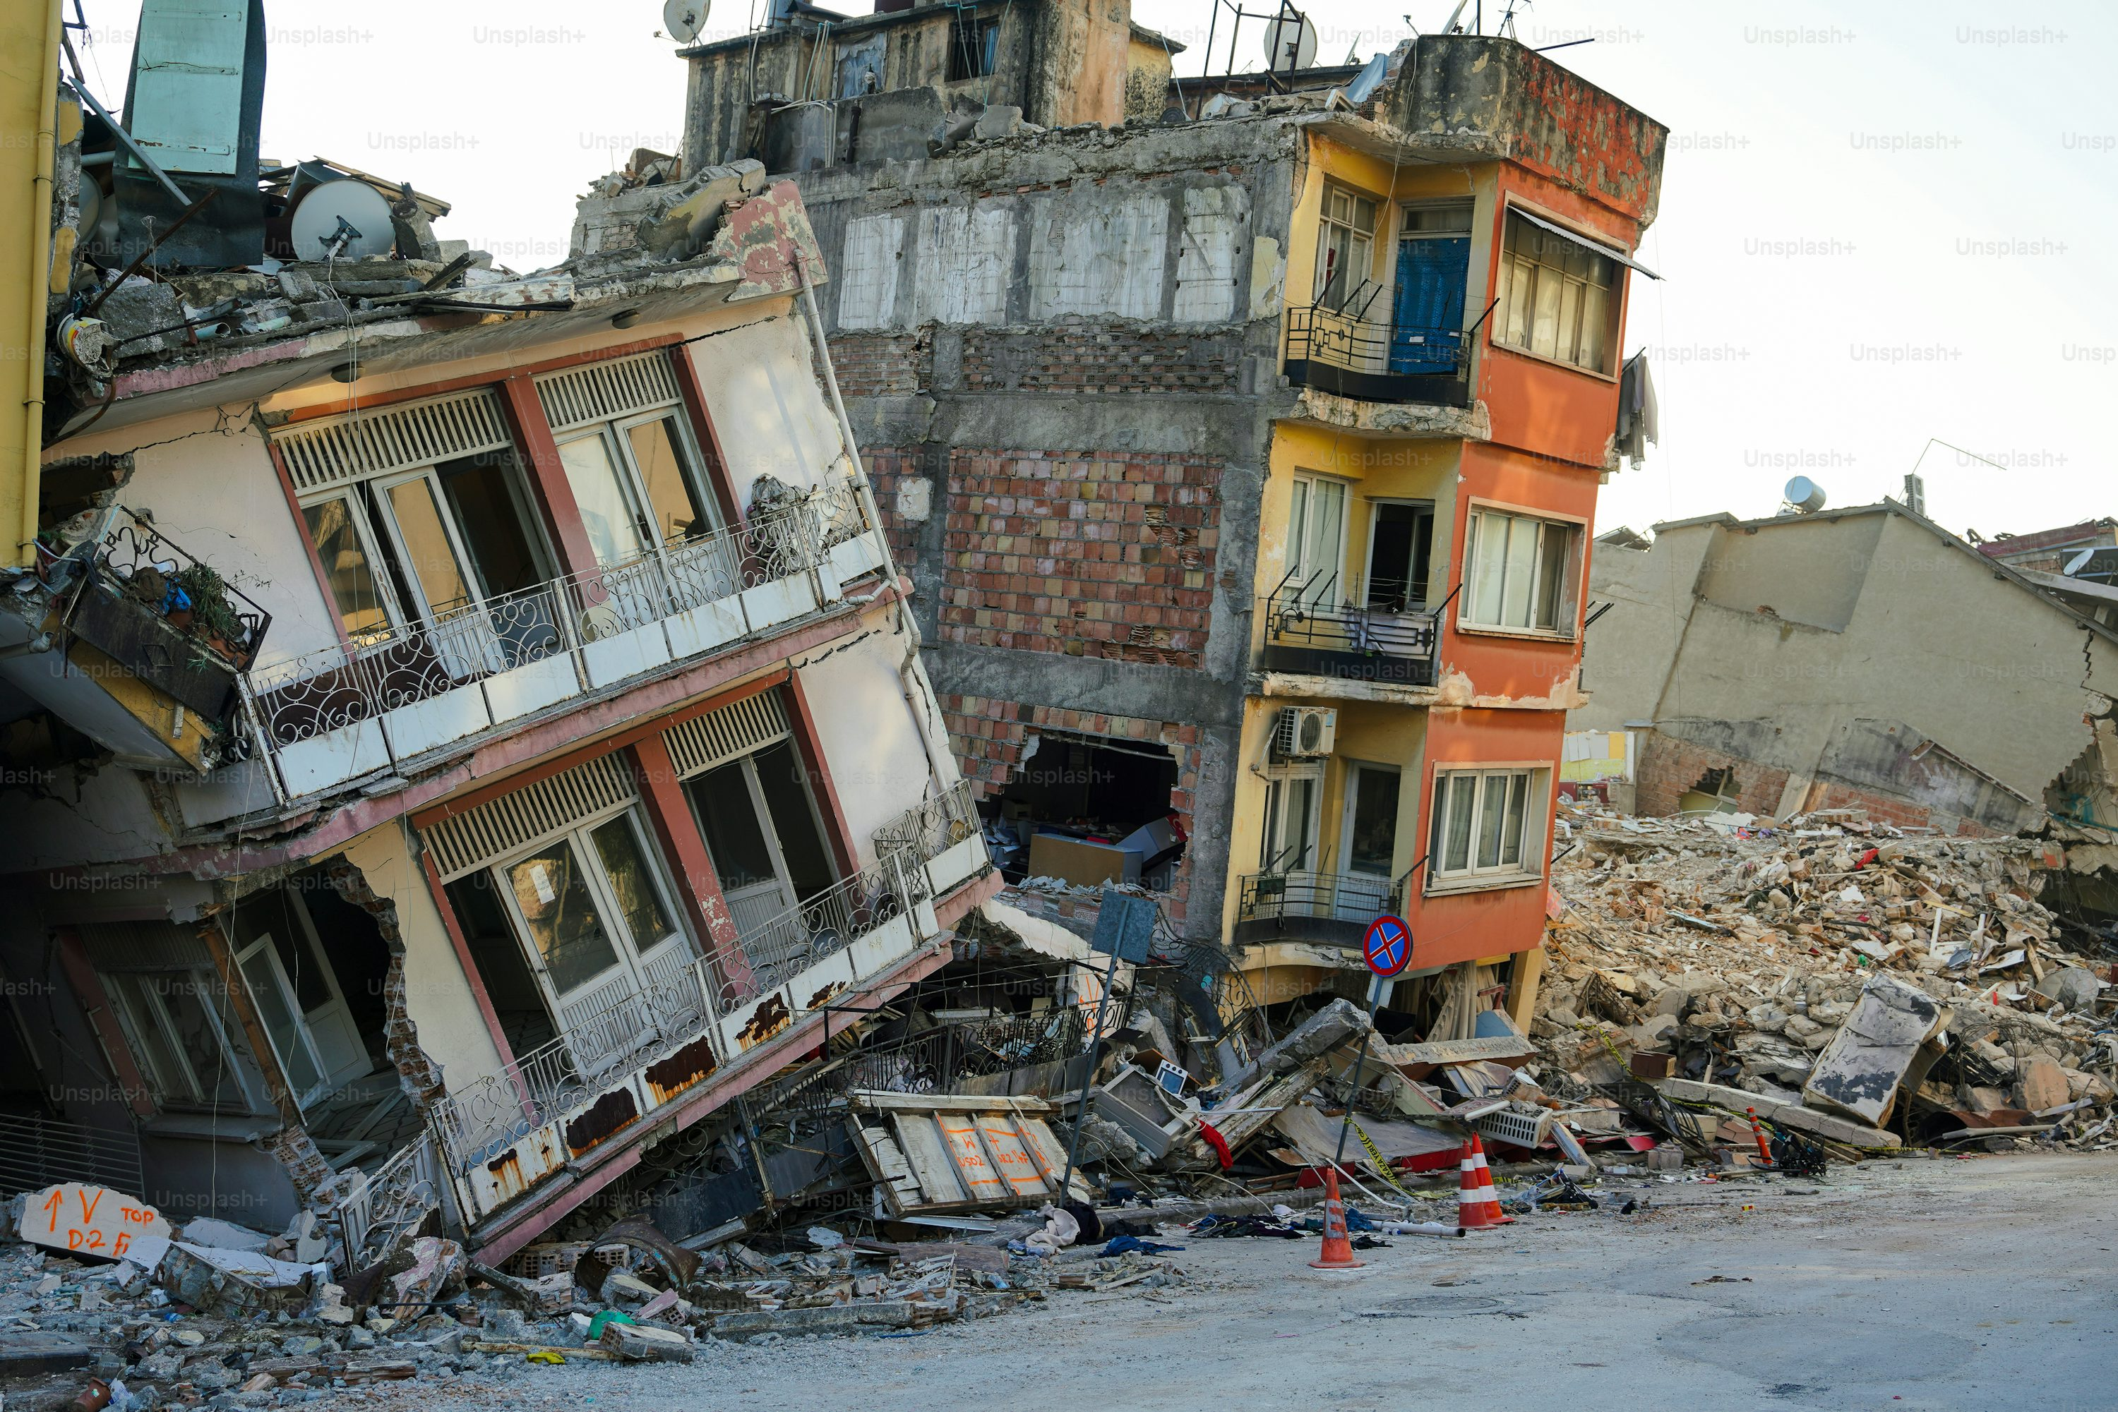
introduction
Even though weather forecasts have improved, people in South Africa still struggle with water and sanitation during extreme weather like heavy rains and droughts. These challenges often lead to flooding, dirty water, and higher risks of diseases that spread through water.

Slide 3

Objectives
Develop a System using machine learning to predict severe weather.
To Analyse the impact on water and sanitation systems

Slide 4
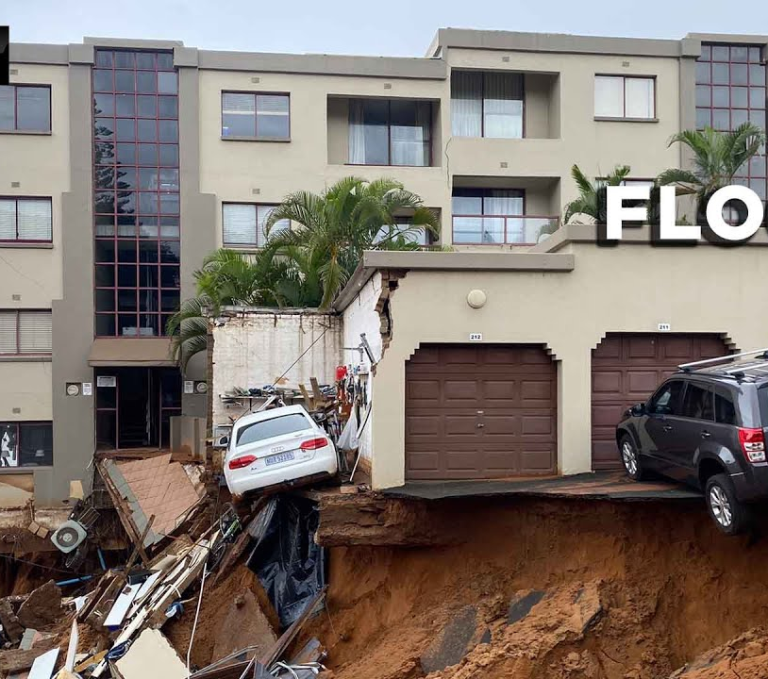
Key Tools and Data Sources
Utilize IBM’s tools for machine learning.
Incorporate public data, including:
Historical weather reports.
Water quality records.
Infrastructure strength assessments.
Benefits:
Improved management of water resources.
Real-time updates and predictions for communities.
Enhanced resilience of water and sanitation systems.
Community Impact:
Better preparedness for severe weather events.
Support for sustainable water management practices.
.

Slide 5
Wow Factors
By blending machine learning, real-time data, and community involvement, the solution not only predicts and reduces the effects of extreme weather but also gives communities useful information they can act on
Improved water resource management.
Real-time updates and predictions.
Increased resilience of water and sanitation systems
This forward-thinking approach can greatly improve public health and make infrastructure stronger and more reliable.

Slide 6
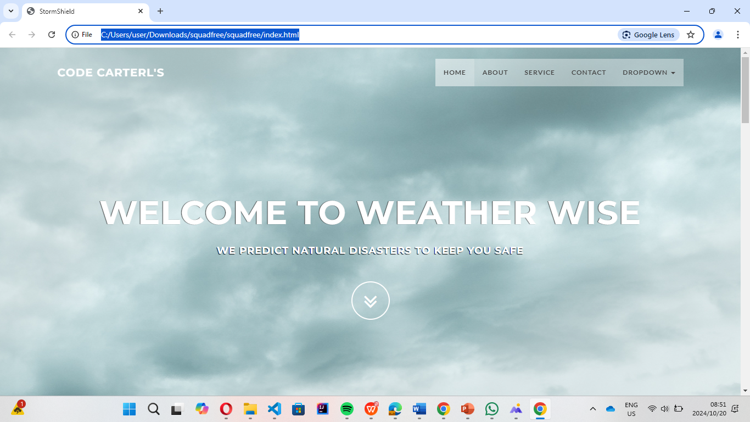
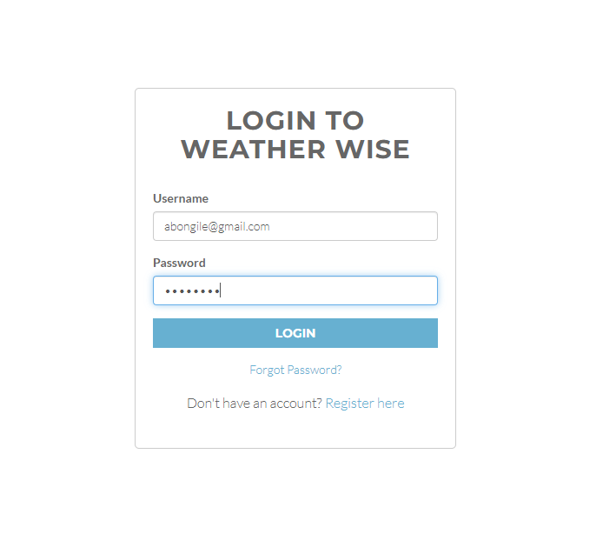
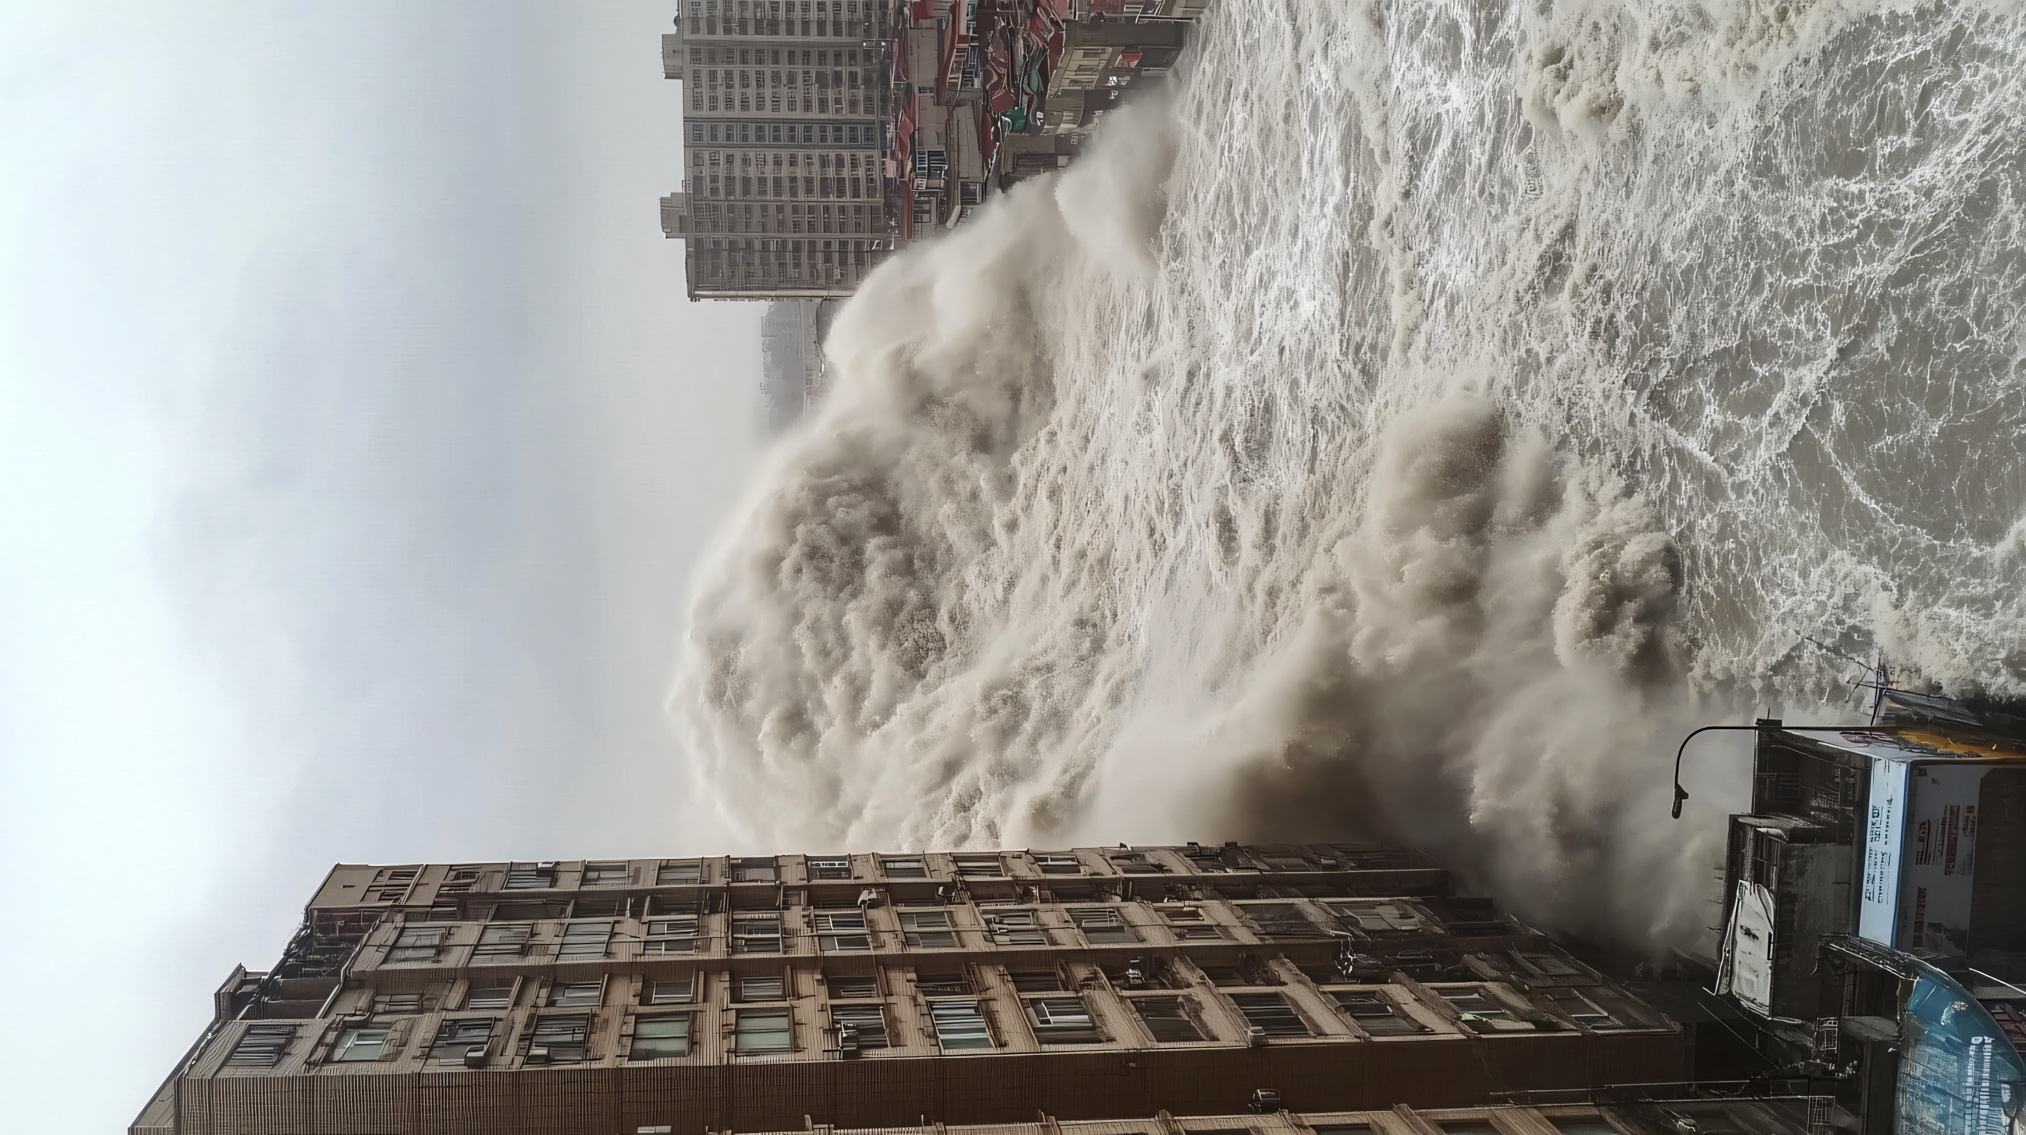
Prototype of System
.

Slide 7
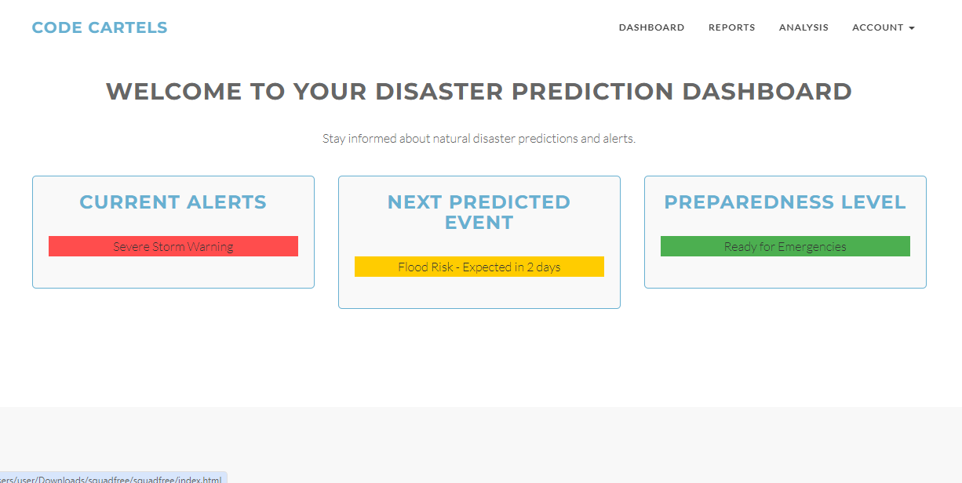
System Dashboard for Upcoming Predictions

Slide 8
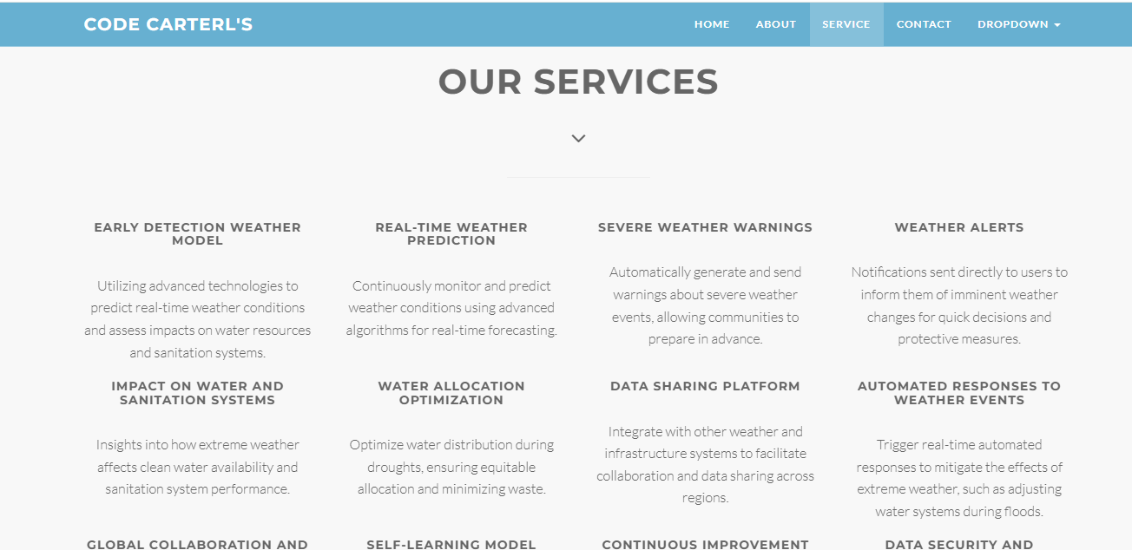
Services offered

Slide 9
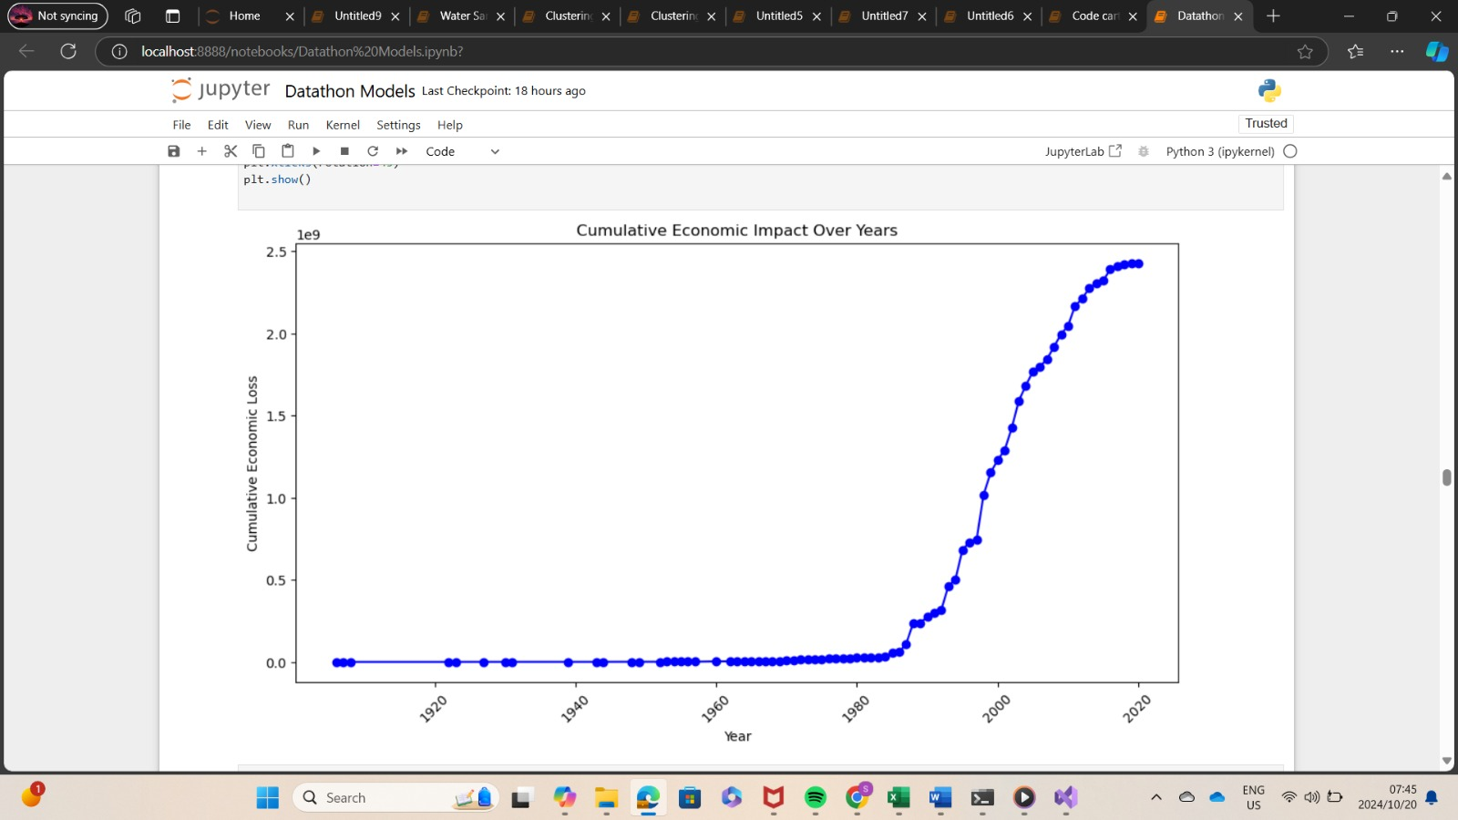
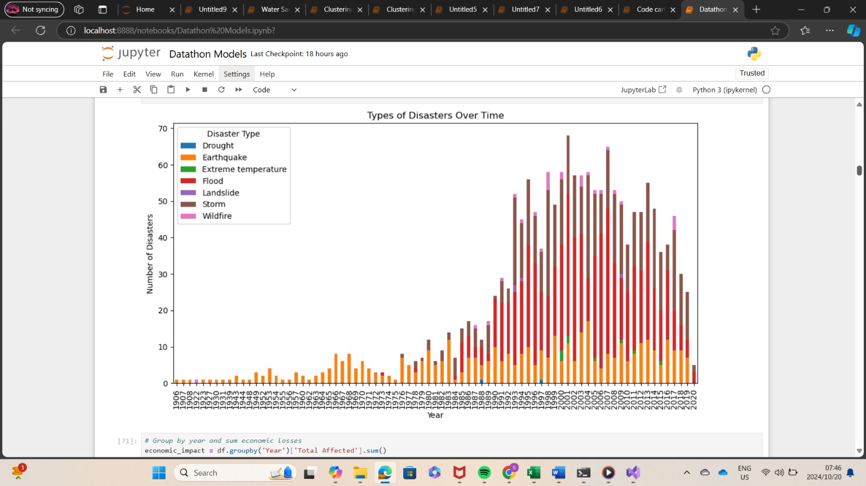
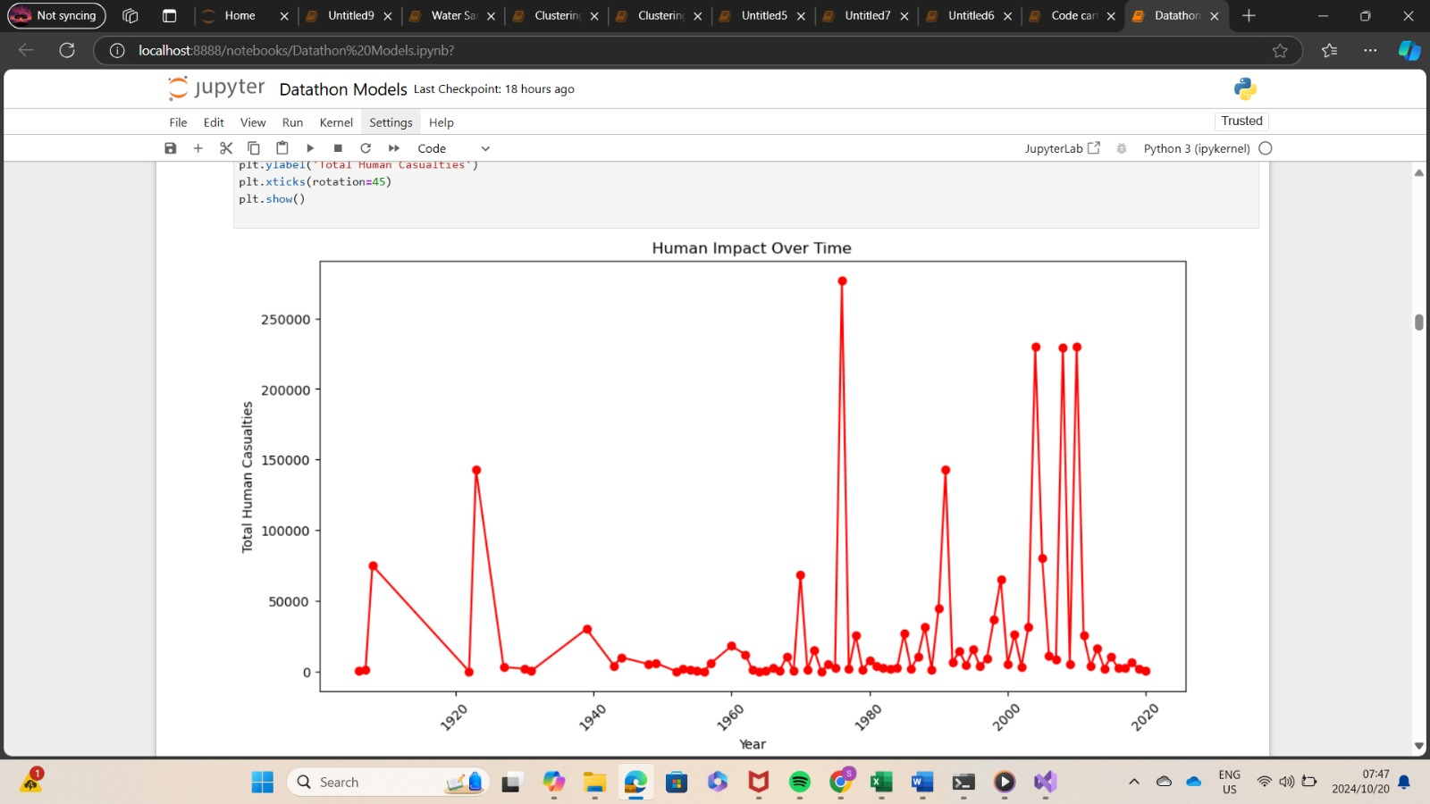
Visualizations
Natural disaster analysis

Slide 10
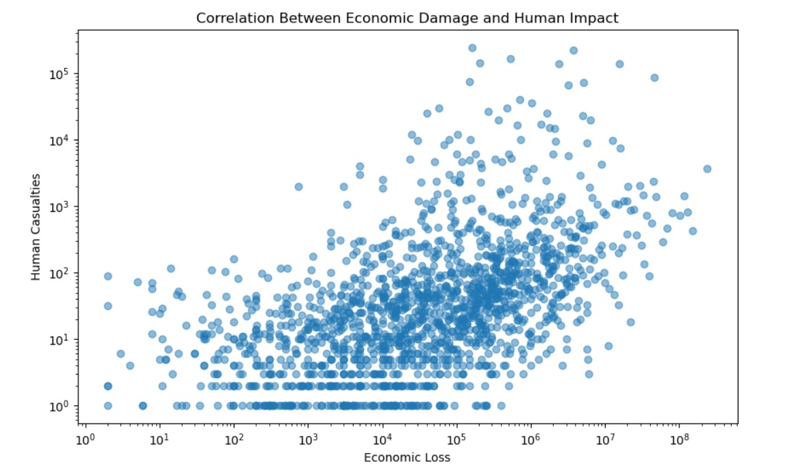
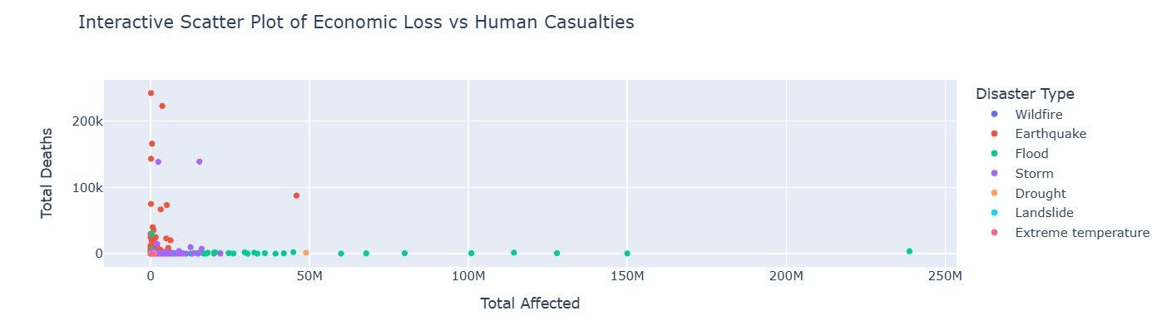
Table

Slide 11

April@www.proseware.com

Slide 12
Customize this Template
Template Editing Instructions and Feedback

